Slide 1

Online Music Store

Slide 2

SMT.TANUBEN & Dr. MANUBHAI TRIVEDI COLLEGE OF INFORMATION SCIENCE (BCA)
Veer Narmad South Gujarat University , Surat
Minor project report
On
HILYRICS
For
Subject : 501- 1 Advanced Web Designing
SUBMITTED BY:-
DHRUVI VAVADIYA
Seat No. 2015
GUIDED BY :-
PRO.BHAUTIKA PATEL

Slide 3
OVERVIEW
Introduction
Scope
Objective
Technologies
UML (USECASE)
XAMPP
Functionalities
Screenshots
References

Slide 4
INTRODUCTION
An online music store website is a platform that allows users to browse and download music from artists.
Online Music Store is a website that contains recent BOLLYWOOD songs.
User can listen as well as download the songs.
Songs are stored in database in the form of bytes.
Easy to access and very user friendly(Responsive) UI.

Slide 5
SCOPE
The scope of a music website can very depending on its specific goals and target audience. User can listen as well as download the songs.
Some music websites may also offer additional services like music news, concert listings, music-related articles and even opportunities for artists to upload their own music.
Music achieve many things. It can be used to communicate information and emotions.
Ex: music Companies, advertising ,etc.

Slide 6
OBJECTIVE
The main objective of the "Hi-Lyrics" is to make available a user-friendly platform available for the consumers where they can conveniently access songs as per their needs. The system can act as one collection of the musical needs of the user.
Also, using this system, the user can create playlist, download songs for offline mode, list their favourite songs Playlist, etc.
In totality, this system is recreational in nature and will provide with free services to the users who make use of it.

Slide 7
TECHNOLOGIES BUILD THE PROJECT
BACK END
FRONT END
BOOTSTRAP4
CSS3
HTML5
Apache(web server)
Relational database : MYSQL (for storing and managing data)
Hypertext Preprocessor(PHP)
JAVASCRIPT

Slide 8
XAMPP
XAMPP is a free and open source cross platform web application.
XAMPP is used for web development on our local machine.
XAMPP is an acronym for
X
A
M
P
P
Cross Platform
Apache Http Server
Perl
MySQL
PHP

Slide 9
MODULES AND ITS FUNCTIONALITIES
Admin Module
Login
Forget password
Maintain song
View Contact Us
View Feedback
View Report
Logout

Slide 10
User Module
Login
Registration
Create Playlist
Add song any Playlist
Search Song
Logout
Give Feedback
Download song

Slide 11
Guest Module
Download song
Search Song
About US
Contact US
Give Feedback
Play Song

Slide 12
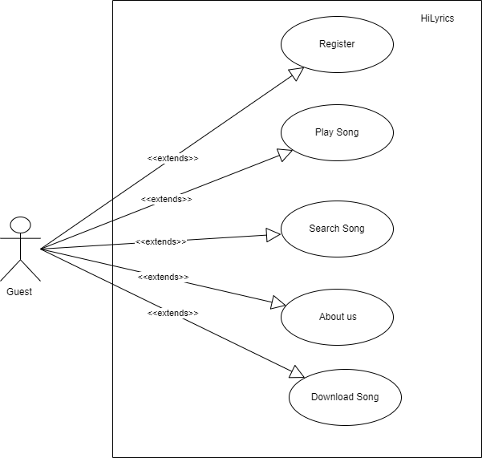
UML Diagrams
Guest User :-
(With Out Login)

Slide 13
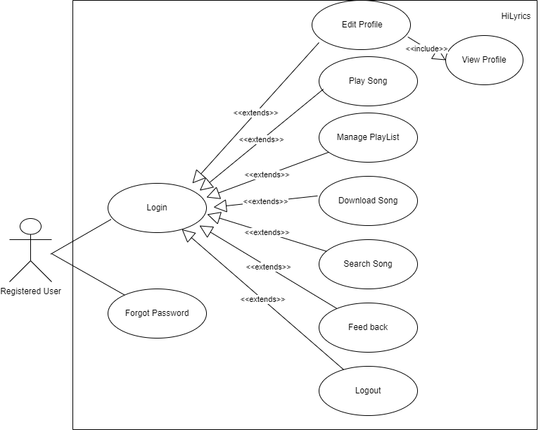
Registered User :- (With Login)

Slide 14
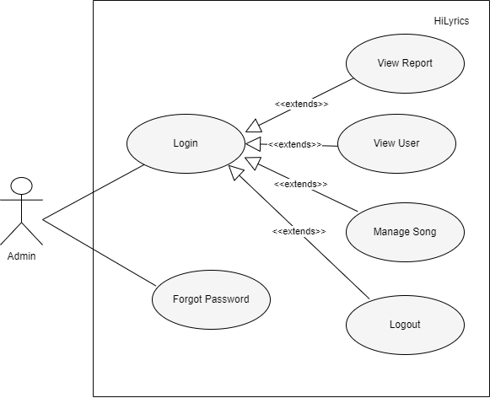
Admin :- (Owner)

Slide 15
TABLE STRUCTURE
Admin
Serial No | Field | Data Type | Null | Description
1 | ADMIN ID | INT(11) | No | Primary Key
2 | NAME | VARCHAR(50) | No | Admin Name
3 | PASSWORD | VARCHAR(50) | No | Admin Password
4 | EMAIL | VARCHAR(50) | No | Admin Email
Artists
Serial No | Field | Data Type | Null | Description
1 | ARTIST ID | INT(11) | No | Primary Key
2 | NAME | VARCHAR(50) | No | Artist Name
3 | GENDER | VARCHAR(10) | No | Artist Gender
4 | PICTURE | VARCHAR(30) | No | Artist Picture
5 | TYPE | VARCHAR(30) | No | Artist Type

Slide 16
Contact
Serial No | Field | Data Type | Null | Description
1 | CONTACT ID | VARCHAR (30) | No | Primary Key
2 | Name | VARCHAR (30) | No | Contact No
3 | MESSAGE | VARCHAR (150) | No | Message
4 | EMAIL | VARCHAR (50) | No | Email
5 | Date | DATE | Yes | Date
Song
Serial No | Field | Data Type | Null | Description
1 | SONG_ID | INT (10) | No | Primary Key
2 | NAME | VARCHAR (50) | No | Song Name
3 | TYPE | VARCHAR (50) | No | Song Type
4 | LANGUAGE | VARCHAR (50) | No | Song Language
5 | ARTIST ID | INT (10) | No | Foreign Key
6 | AUDIO_FILE | VARCHAR(50) | No | Audio file
7 | SONG_PIC | VARCHAR(200) | No | Song Picture
8 | CREATED_DATE | Date | Yes | Date

Slide 17
User
Serial No | Field | Data Type | Null | Description
1 | USER_ID | INT (10) | No | Primary Key
2 | NAME | VARCHAR (50) | No | User Name
3 | EMAIL | VARCHAR (50) | No | User Email
4 | PASSWORD | VARCHAR (50) | No | User Password
5 | MOBILENO | VARCHAR (10) | Yes | User Mobile number
6 | GENDER | VARCHAR (50) | No | User Gender
7 | DOJ | DATE | Yes | Date Of joining
Feedback
Serial No | Field | Data Type | Null | Description
1 | FEEDBACK ID | INT (11) | No | Primary Key
2 | EMAIL ID | VARCHAR (50) | No | User email id
3 | COMMENT | VARCHAR (150) | No | Comment
4 | Date | DATE | Yes | Date

Slide 18
Playlist
Serial No | Field | Data Type | Null | Description
1 | PLAYLIST ID | INT (11) | No | Primary Key
2 | PLAYLIST NM | VARCHAR (50) | No | Playlist name
3 | USER ID | INT (11) | No | Foreign Key
4 | YEAR | INT(4) | Yes | Created Year
Playlist_ Details
Serial No | Field | Data Type | Null | Description
1 | PD_ID | INT (11) | No | Primary Key
2 | PLAYLIST ID | INT (11) | No | Foreign Key
3 | SONG_ID | INT (10) | No | Foreign Key

Slide 19
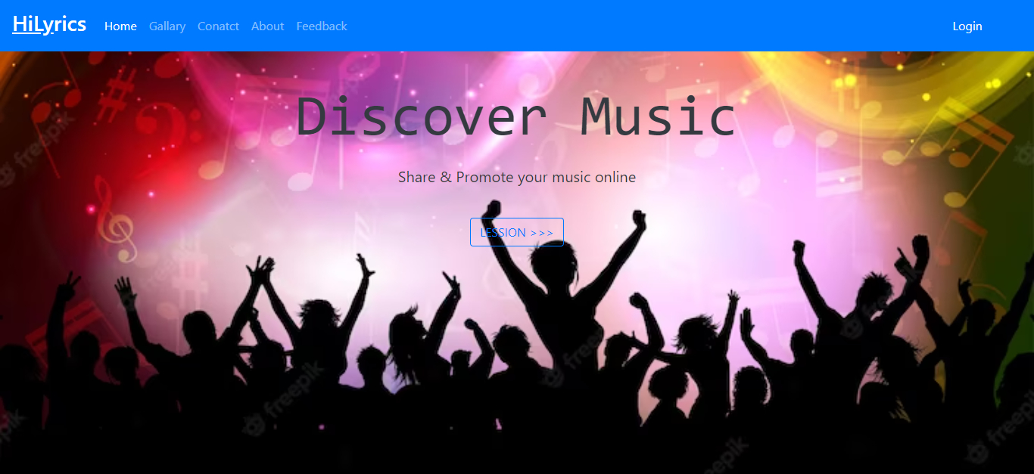
SCREENSHOTS
Home Page

Slide 20
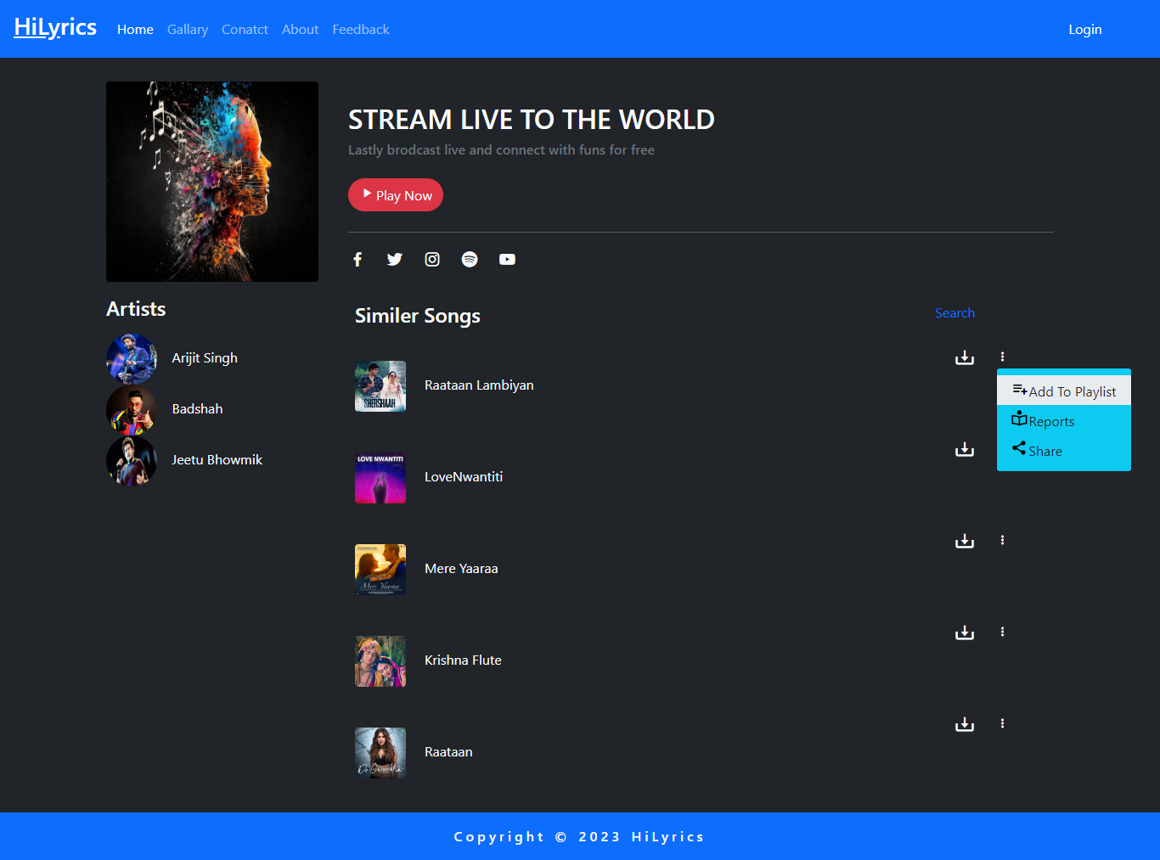
Gallery

Slide 21
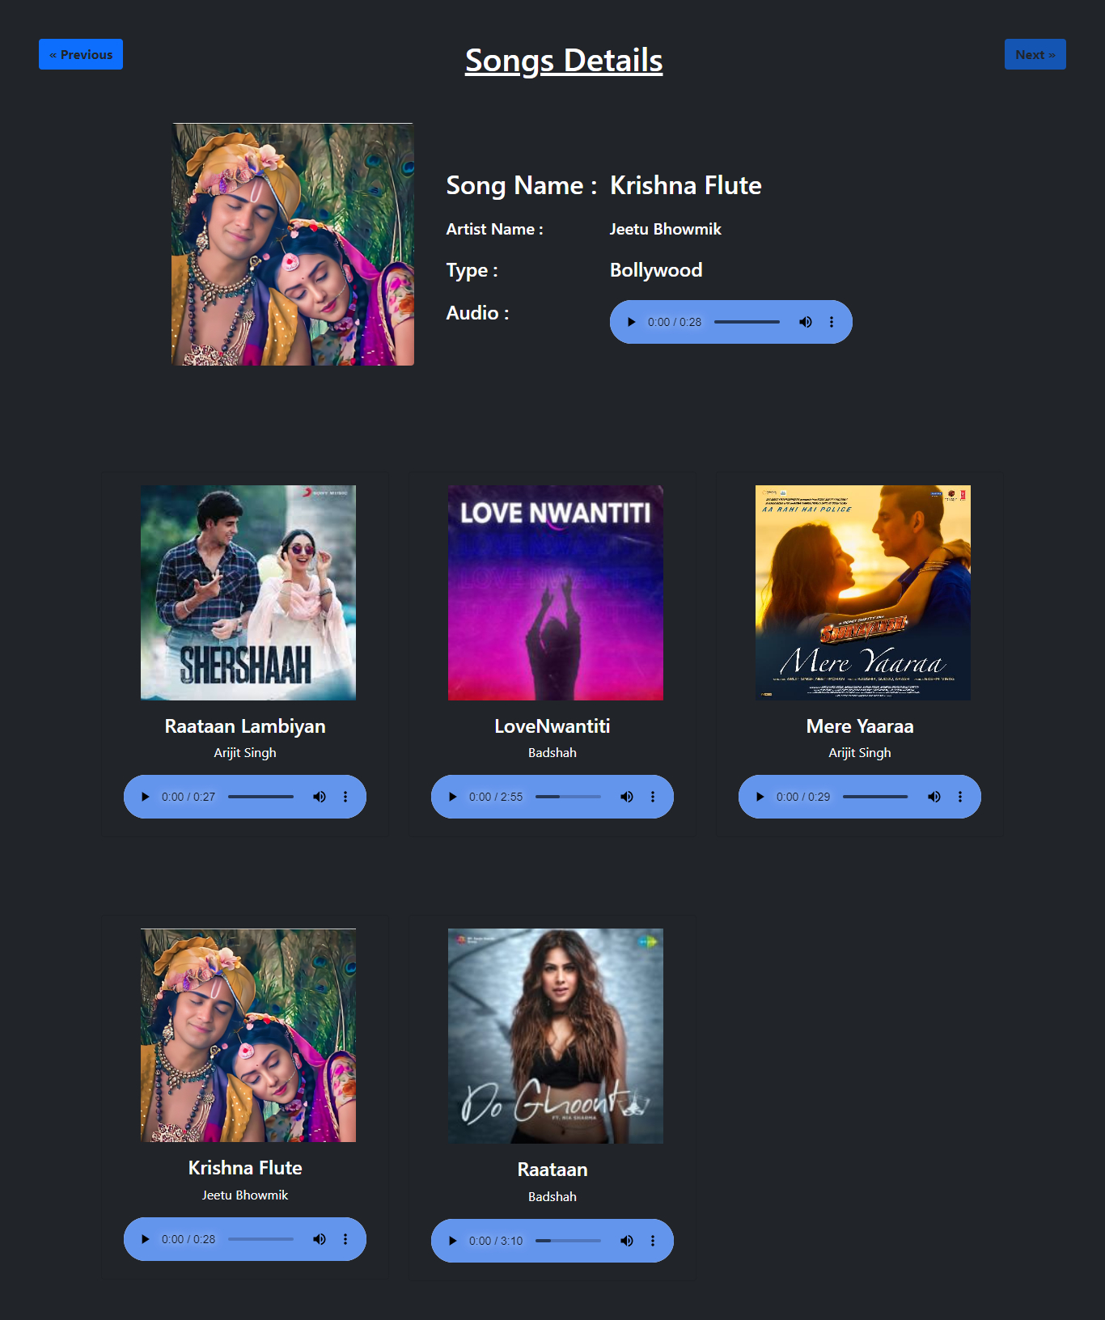
Play Songs

Slide 22
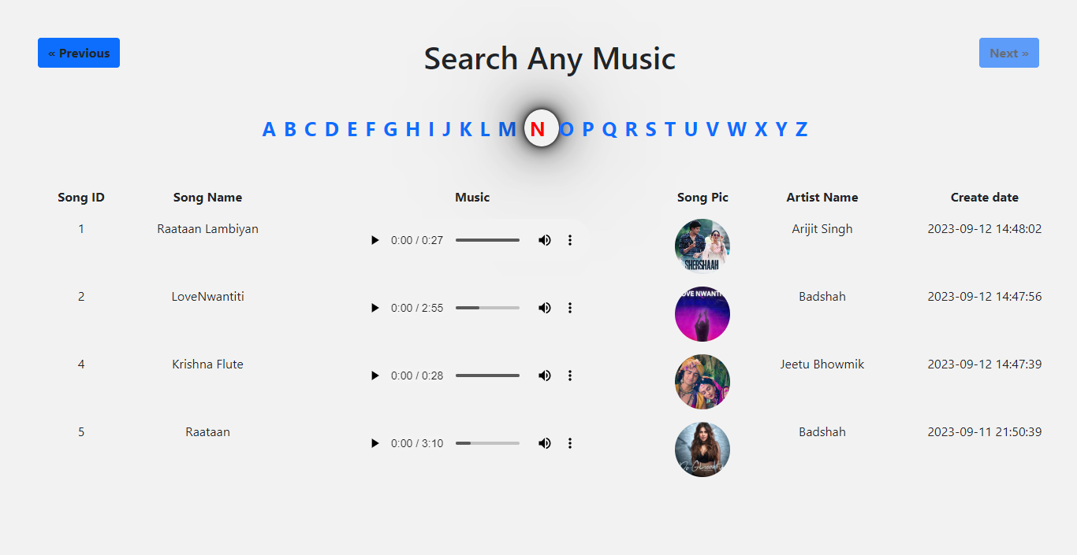
Search Songs

Slide 23
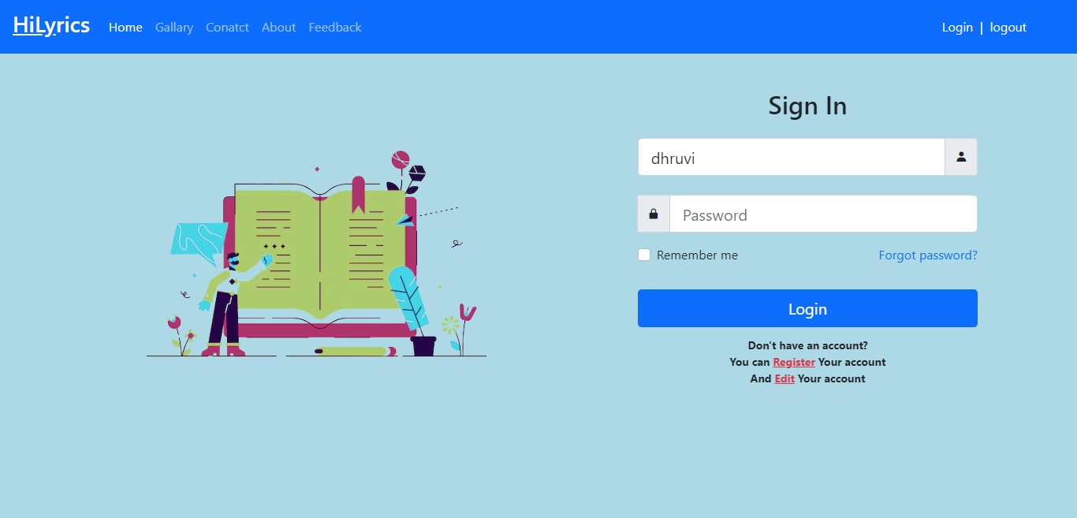
User Login

Slide 24
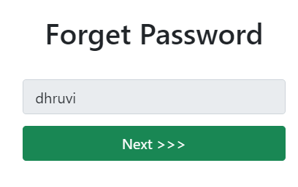
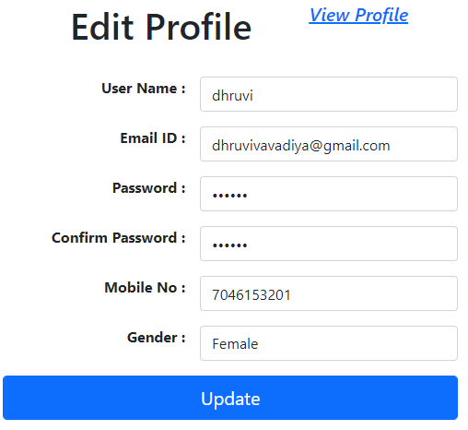
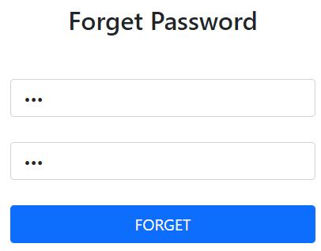

Slide 25
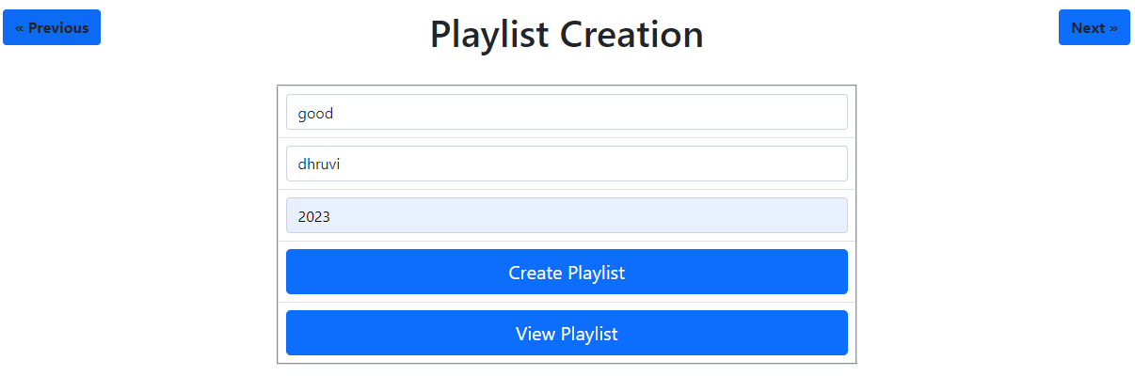
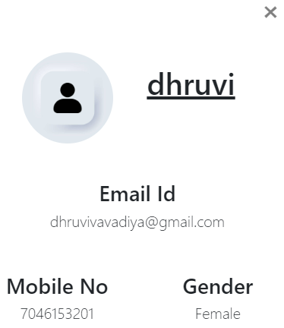
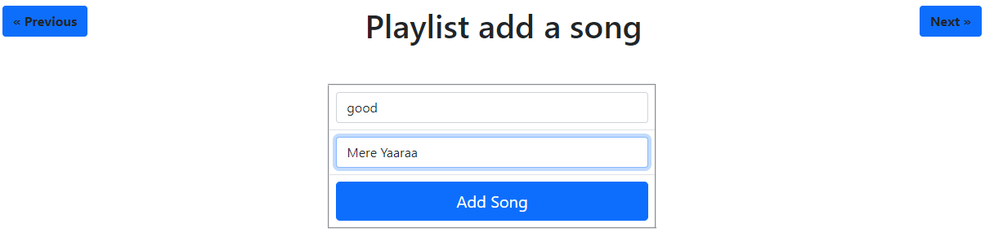
Playlist Details
View Profile

Slide 26
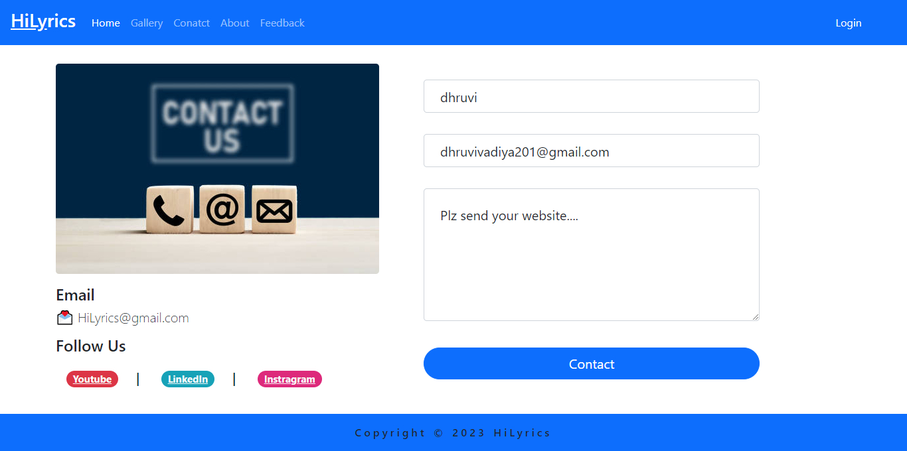
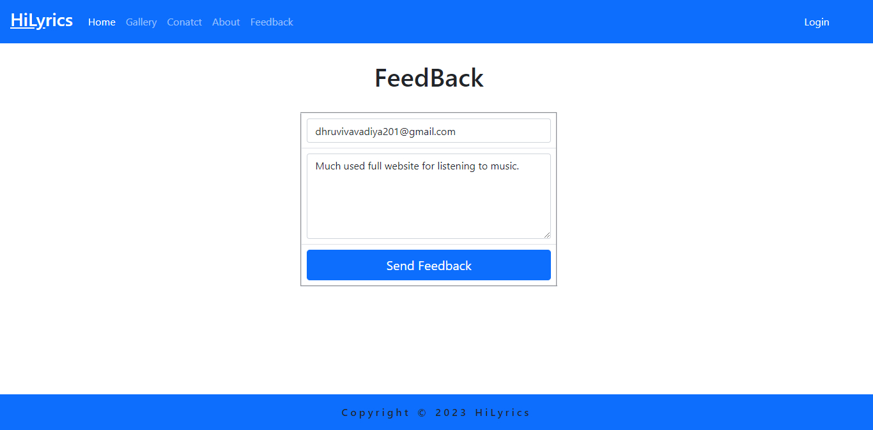
Contact US
Feedback

Slide 27
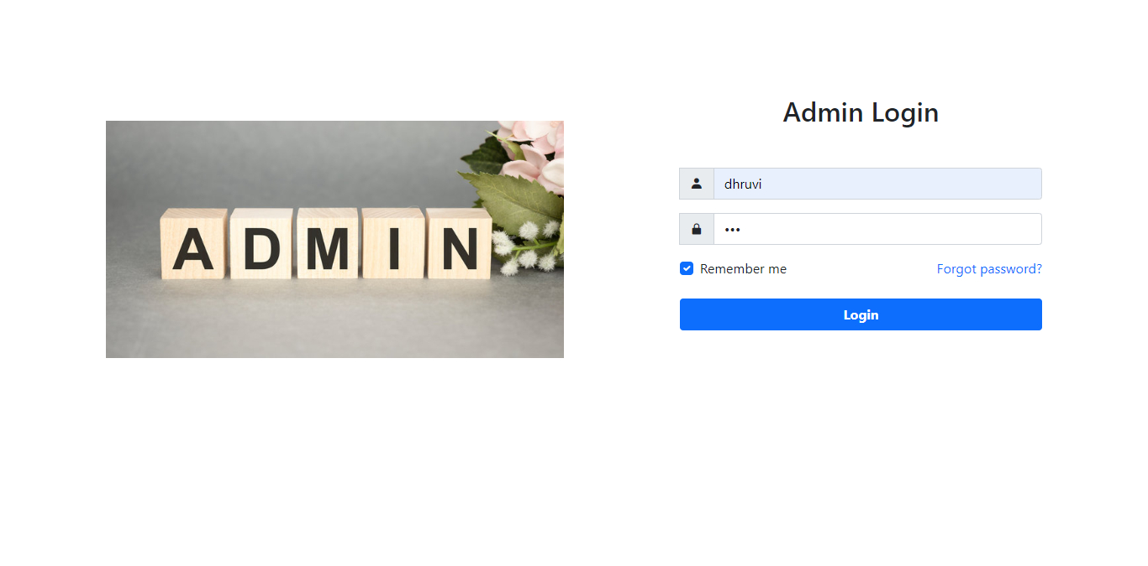
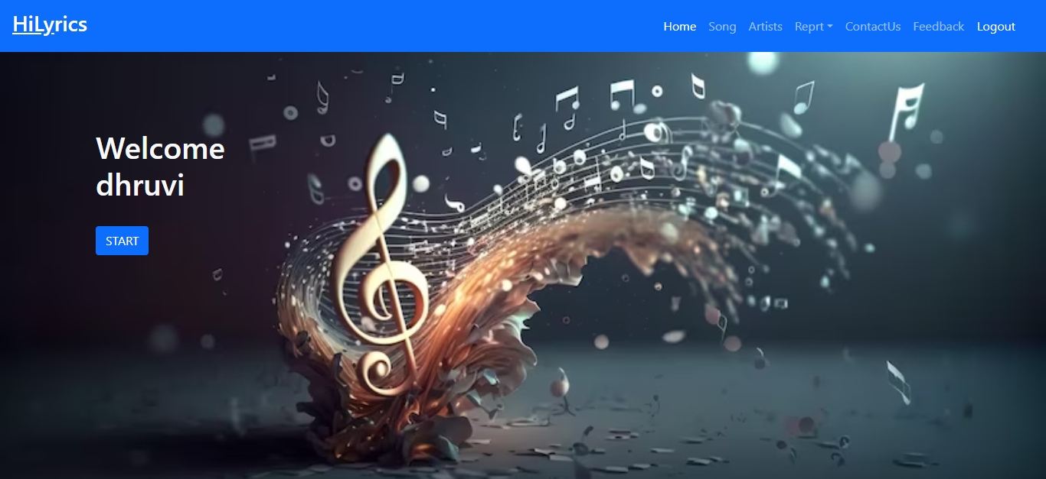
Admin Login

Slide 28
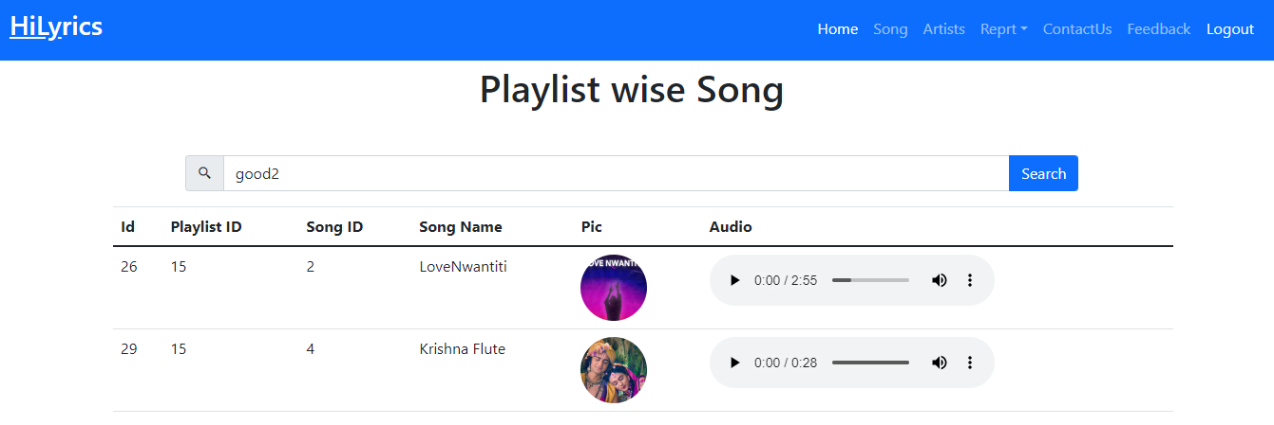
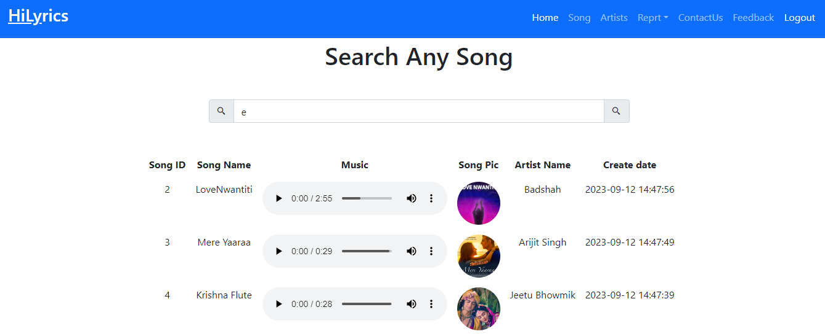
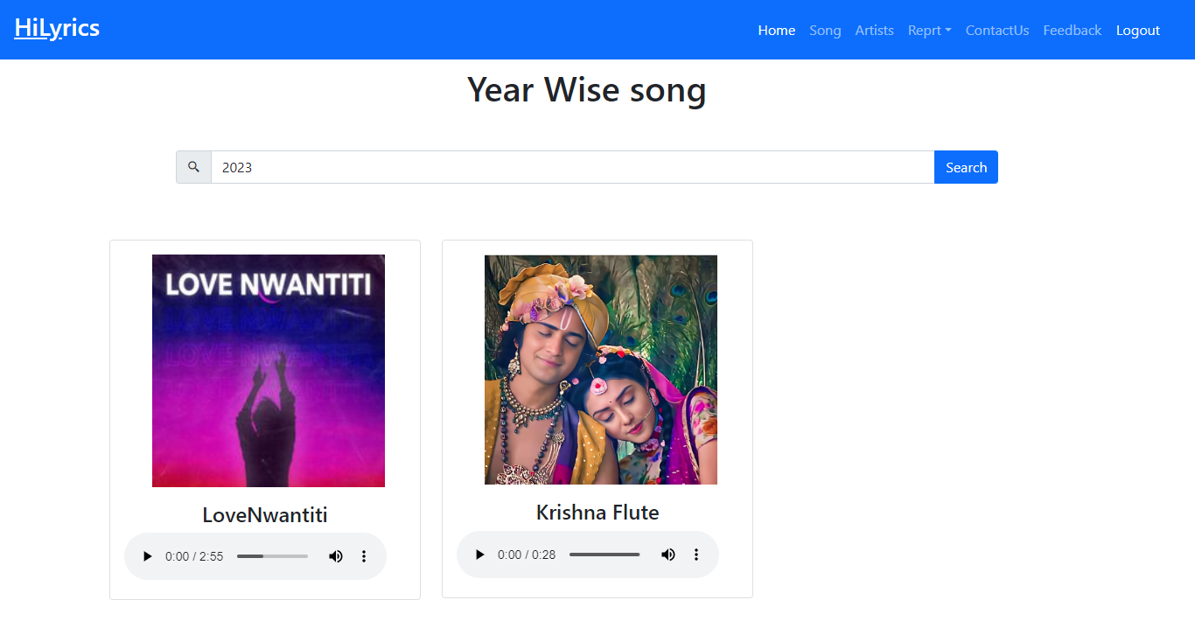
Report

Slide 29
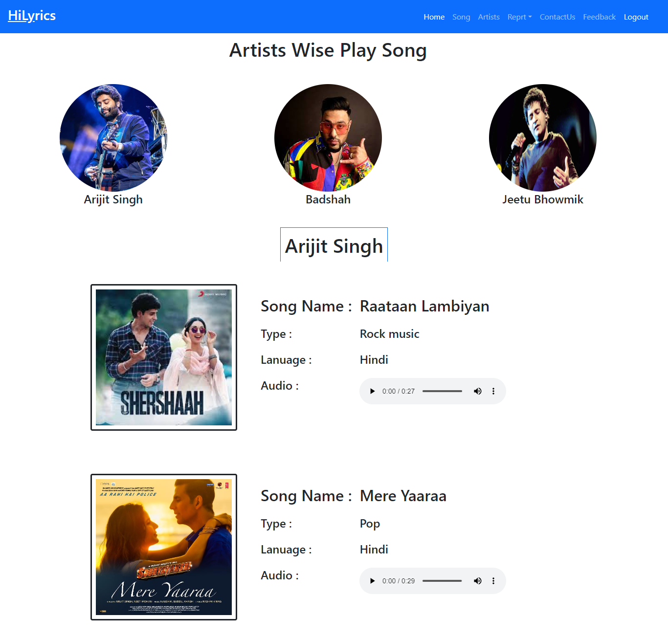

Slide 30
FUTURE ENHANCEMENT
Song Update and Delete
To generate Reports
Add Premium
High-quality audio

Slide 31
REFERENCES
https://www.w3schools.com/php/
https://www.geeksforgeeks.org/php-tutorial/
https://www.tutorialspoint.com/phpmyadmin/
https://stackoverflow.com/questions/2535962/connecting-to- phpmyadmin-database-with-php-mysql/
https://www.freecodecamp.org/news/how-to-get-started-with-php/

Slide 32
Thank You

